Slide 1
Is space time?
Matt Gudorf, Predrag Cvitanović

Slide 2
Motivation
Simulations in which one can find exact coherent structures (periodic orbits, invariants) of dissipative flows have been generally been confined to small computational cells, far from the physical reality of spatially extended systems. We elect to view time invariant structures of a flow to be spatiotemporal tiles that enumerate a spatiotemporal state space. The basis of this investigation is to see whether these tiles give a road to building large spatiotemporal solutions from smaller ones. We, of course, would like to go to infinite spatiotemporal domains and then compute statistics based on the frequency at which certain patterns occur. Also, we hope to construct a spatiotemporal symbolic dynamics with which we can construct arbitrarily complex solutions.

Slide 3
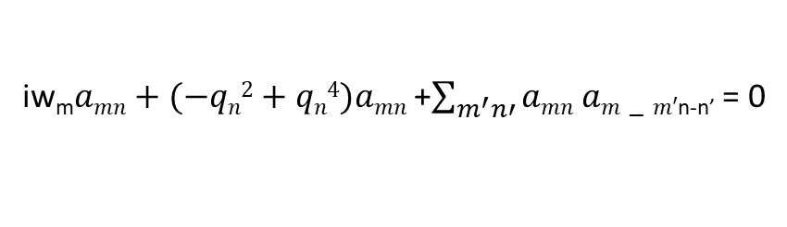

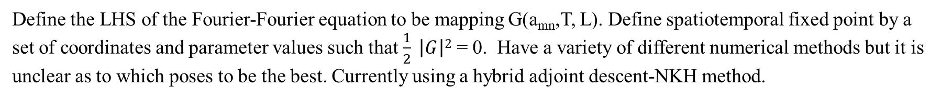
Method
Need to determine a library of spatiotemporal fixed point solutions that satisfy the following equation
u_{t}$−uxx+uxxxx −uu$_{x} = 0
iw_{m}$amn+(−qn2+qn4)amn$ +$\sum_{m^{′}n′}{amn am−m′\text{n}\text{-}\text{n}\text{’}}$ = 0
Define the LHS of the Fourier-Fourier equation to be mapping G(a_{mn},T, L). Define spatiotemporal fixed point by a set of coordinates and parameter values such that $\frac{1}{2} \left|G\right|2$ = 0. Have a variety of different numerical methods but it is unclear as to which poses to be the best. Currently using a hybrid adjoint descent-NKH method.
Difficulties
We are computing unstable solutions of a PDE such that both the period and domain size are allowed to vary, to my knowledge no one does this. While the fourth derivative term is beneficial in the implicity time-dependent system due to the dissipation, here it creates a large instability and sensitivity to changes in higher wavenumber modes. Symmetry also plays an interesting rule due to conjugacy conditions of the spatiotemporal Fourier modes, quotienting of these symmetries are baked into the custom definitions of Fourier transforms such that we discard all zero-valued modes before solving for anything numerically.

Slide 4
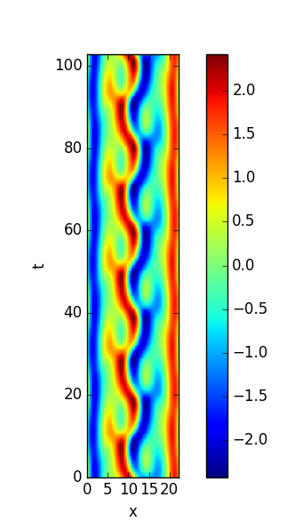
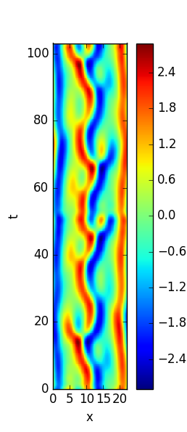
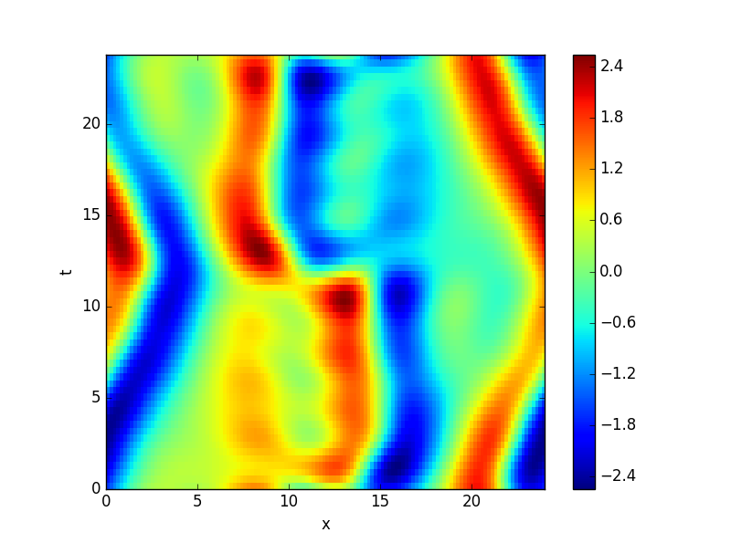
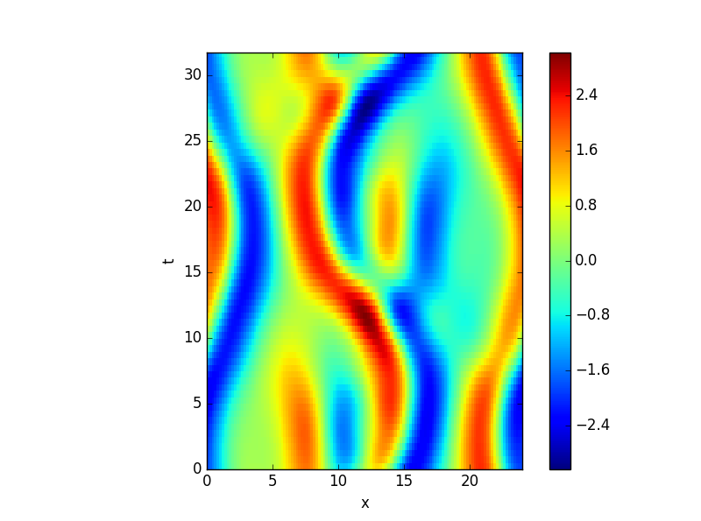
Current Results
It seems the global descent method here brought us to an orbit that the initial condition is shadowing, as it seems to be five repeats of a much shorter periodic orbit.
Had to “”cheat”” here. The initial condition was first made to converge with only time-varying at first before it could get to a region where it converged spatiotemporally.

Slide 5
Once all numerical issues are ironed out, and a large library of solutions is computed, we need to try to develop statistics as well as symbolic dynamics. My general sense on the following is thus. Assume multiple spatiotemporal tiles have been found and are enumerated by 0,1,2, … then we should be able to formulate arbitrarily large solutions in such a manner so long as the symbolic dynamic pattern (now a multidimensional itinerary as opposed to a bi-infinite string).
Spatiotemporal Fixed points comprising ‘Library’ of solutions
Composite Solution
Symbolic Dynamics representation
1
3
3
3
2
2
0
1
2
0
1
0

Slide 6
General Ergodic trajectory, enclosed by dashes indicate fractional area of solution from library. Cycle expansion shows shorter orbits are more important, perhaps spatiotemporal area has same property. Calculate statistics based on amount of area corresponds to spatiotemporal fixed point.
Statistical frequency of spatiotemporal solutions
Library of solutions
1
3
2
0

